Slide 1

IDS alert
strengthening
and
prioritization
UAlbany
Venkata Sai Arun Vemuri

Slide 2
Project Overview – problem description
Can we combine multiple weak signals into one strong?
Can we detect both ongoing and pending intrusions?
How do we Prioritize IDS alerts?
How do we reduce false positives?

Slide 3
Findings - Dataset review
CSE-CIC-IDS2018 on AWS
Created by University of New Brunswick
Dataset includes seven different attack scenarios: Brute-force, Heartbleed, Botnet, DoS, DDoS, Web attacks, and infiltration of the network from inside
Attacking infrastructure includes 50 machines and the victim organization has 5 departments and includes 420 machines and 30 servers
Includes the network traffic captures and system logs of each machine, along with 80 features extracted from the captured traffic
CSE-CIC-IDS2018
Our Chosen Dataset

Slide 4
Findings - Literature review
Create a scoring system from flow data to supplement the IDS alerts using ML algorithm which are K-Means (unsupervised), Random Forest, and Decision Trees (both supervised)
the treatment was centered around the creation Prioritization Score that takes the probability of all the malicious attack predictions and create a score from 0-100.
DSU Sprig 2019
Created a model using Basic DNN and Attention Model (because of temporal dependency in the data).
The 80 features of the dataset was reduced to14 by using Decision Tree to split the into homogeneous groups.
UTDallas Fall 2019
They have made use of Decision tree, Random forest, Ada Boost, Long Short-term Memory (LSTM) as a part of research to determine which algorithms should be run against the dataset to produce the most promising result and increase the IDS alert accuracy.
They ran the top 40 features on Random Forest and Decision Tree, as well as all 80 features on Ada boost, using the 80 features. With all 80 features, the findings preferred Ada boost.
UofArizona Fall 2020
They used the ELK stack (Elasticsearch, Logstash and Kibana) for visualization of the data. The algorithms they chose was: Decision tree, Random forest, Ada boost and MLP classifier.
Trained on 14 features using the algorithms. Out of all the algorithms, Random Forest turned out to be the best model because the recall of Random Forest is better. This means bad traffic predicted as good traffic is less in the model when compared to Decision Tree model.
UlAbany Fall 2021

Slide 5





Project Overview – PHASES
Literature Review
ANALYZING Datasets USED BY PREVIOUS GROUPS
Meta Analysis
Till date OF PREVIOUS GROUPS
EXPAND THE Scope OF THE META ANALYSIS using published work
identifying theoretical solution for A BETTER MODEL

Slide 6
description
2
3
4
1
Obtain data
Run Predictions with ML classifiers
Iteratively improve model performance
Recommendations

Slide 7
CSE Dataset description
Attacking infrastructure includes 50 machines; victim organization has 5 departments, 420 machines and 30 servers
Includes network traffic captures and system logs of each machine, along with 80 features extracted from the captured traffic
Created by University of New Brunswick
Seven different attacks: Brute-force, Heartbleed, Botnet, DoS, DDoS, Web attacks, and infiltration of the network from inside

Slide 8
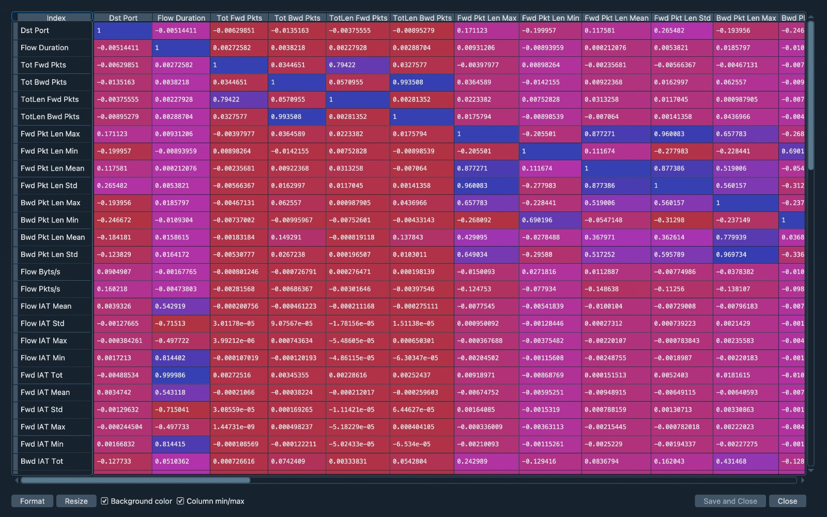
Variable co-relations
We found
positive
co-relations
between
our
top features.
Some of the features
have enough positive
co-relations to deem one of them
ineffective.
Caption

Slide 9
ML RESULTS
ALGORITHM USED | ACCURACY
DECISION TREE | 0.98
RANDOMFOREST | 0.98
MLP | 0.92
ADABOOST | 0.96

Slide 10

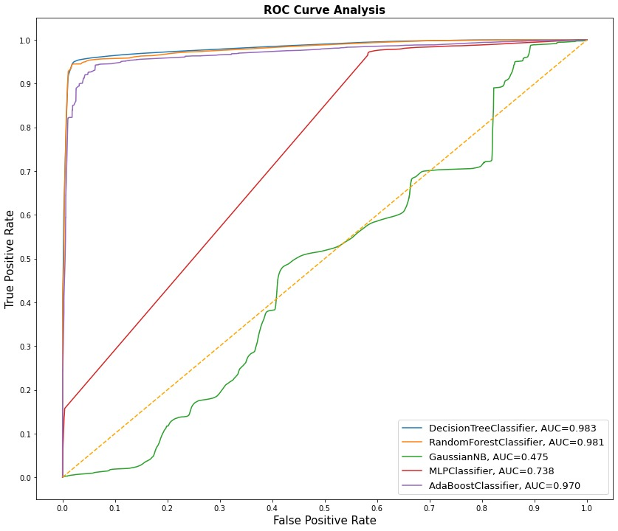
ROC CURVE ANALYSIS
Caption

Slide 11
Findings – META ANALYSIs
Based upon the studies of the InSure Project on IDS alert prioritization and strengthening, we have done about 70% of the Meta analysis on all the universities which worked on this project earlier.
Averagely, all the universities used CSE-CIC-IDS2018 dataset to create their models.
It has been seen from the dataset that the prevalence is given to majority class i.e., benign class which is more than 80%, whereas 0.00039% is for minority class (heart bleed)
Because of above description any IDS may tilt towards benign traffic.
In every IDS also with the growing data automated decision making is required, which demands ML, AI (deep learning techniques) for its future scope.
Many of IDS lack data confidentiality and hence its prime responsibility to identify malicious activities in acceptable time period only.

Slide 12
conclusions
Machine Learning can be used to produce encouraging results
Taken together the efficacy is increased
Further research and additional time is needed

Slide 13



The ENd!
Thank you for your time!
Happy holidays!
Questions Please!

